Slide 1
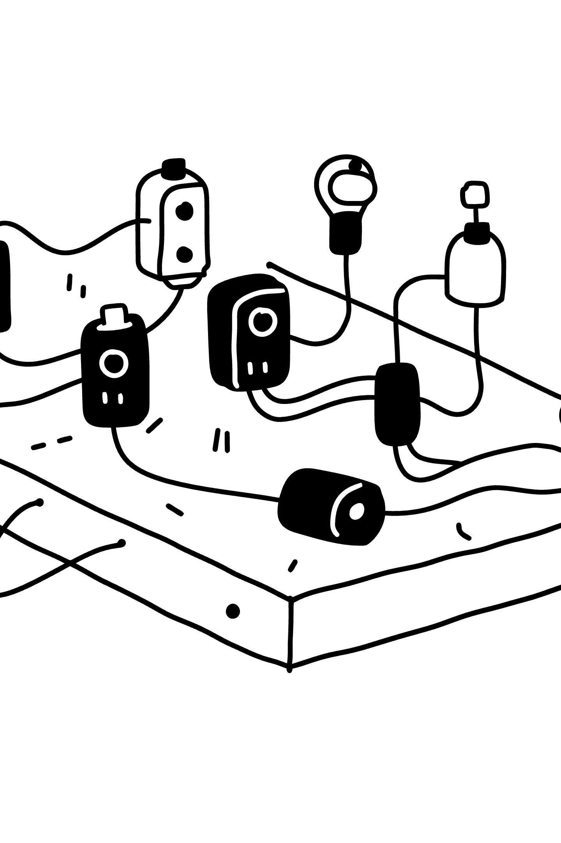
Ransomware: The Digital Hostage Crisis
Understanding, Preventing, and Responding to Modern Extortion
CYBERSECURITY
THREAT AWARENESS

Slide 2


What is Ransomware?
Ransomware is malicious software that encrypts a victim's files or locks their system, demanding a ransom payment to restore access. It is not merely a technical problem — it is a criminal enterprise focused on extortion.
Encryption
Ransom Note
Double Extortion
Files are scrambled, making them completely unusable.
A screen message demands payment in cryptocurrency with a strict deadline.
Attackers steal sensitive data before encrypting it, threatening to leak it if the ransom is not paid.

Slide 3





Common Types of Ransomware
Crypto-Ransomware
Locker-Ransomware
Scareware
Encrypts files on local and connected drives. e.g., Locky, WannaCry
Locks users out of their entire device. e.g., Reveton
Fake security alerts demanding payment for bogus cleanup tools. e.g., WinFixer
Doxware
Mobile Ransomware
Threatens to publish stolen sensitive data online unless the ransom is paid.
Targets smartphones and tablets, locking screens or encrypting device files.

Slide 4
How a Ransomware Attack Unfolds
Most ransomware attacks follow a predictable sequence — understanding each stage helps identify where defenses can intervene.
01
02
Infection
Execution & Staging
Attacker gains access via phishing emails, exploit kits, or weak RDP credentials.
Malware runs, connects to the attacker's server, and spreads laterally across the network.
03
04
Data Exfiltration
Encryption
Sensitive data is stolen and sent to the attacker before encryption begins.
Files, folders, and sometimes entire drives are encrypted, rendering them inaccessible.
05
06
Ransom Demand
Payment & (Maybe) Decryption
A ransom note demands cryptocurrency payment within a set deadline.
The victim pays, but there is no guarantee the attacker will provide a decryption key.

Slide 5


Prevention is the Best Defense
For Individuals
For Organizations
Backups: Follow the 3-2-1 rule — 3 copies, 2 media types, 1 offsite.
Employee Training: Regular security awareness training is essential.
Software Updates: Keep OS, browsers, and apps patched.
Network Segmentation: Limit how far an infection can spread.
Email Hygiene: Never click suspicious links or open unexpected attachments.
Multi-Factor Authentication: Enforce MFA everywhere, especially on RDP.
Antivirus / EDR: Keep security software up to date.
Incident Response Plan: Have a tested plan ready before an attack happens.

Slide 6
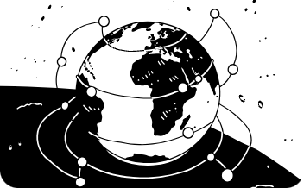

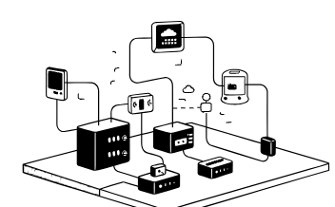
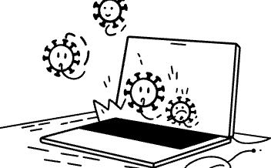
Ransomware in the Headlines
WannaCry (2017)
Colonial Pipeline (2021)
REvil / Kaseya (2021)
CryptoLocker (2013)
Infected 200,000+ computers across 150 countries via the EternalBlue Windows exploit. Hospitals, telecoms, and businesses hit. Ransom: $300–$600 in Bitcoin.
Shut down a major U.S. fuel pipeline, causing gas shortages and panic buying. ~$4.4 million paid to the DarkSide group.
A supply-chain attack affecting up to 1,500 businesses worldwide through a single IT management provider. Ransom demanded: $70 million.
One of the first widespread crypto-ransomware campaigns. Spread via email attachments to Windows PCs. Ransom: 2 Bitcoin or $300. Popularized the modern model.

Slide 7
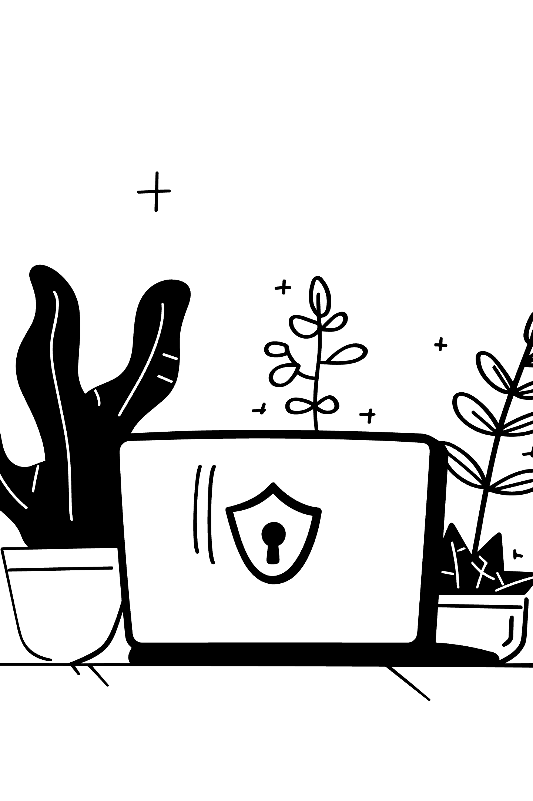
Key Takeaways
A Serious, Evolving Threat
Prevention is Paramount
Ransomware combines technology with extortion, affecting individuals, corporations, and critical infrastructure alike.
Backups, patching, and education remain the most effective defenses against attack.
The Landscape is Shifting
Double extortion and supply-chain attacks are the new frontier — defenses must evolve too.
Cybersecurity is not a product, but a continuous process.

